Slide 1
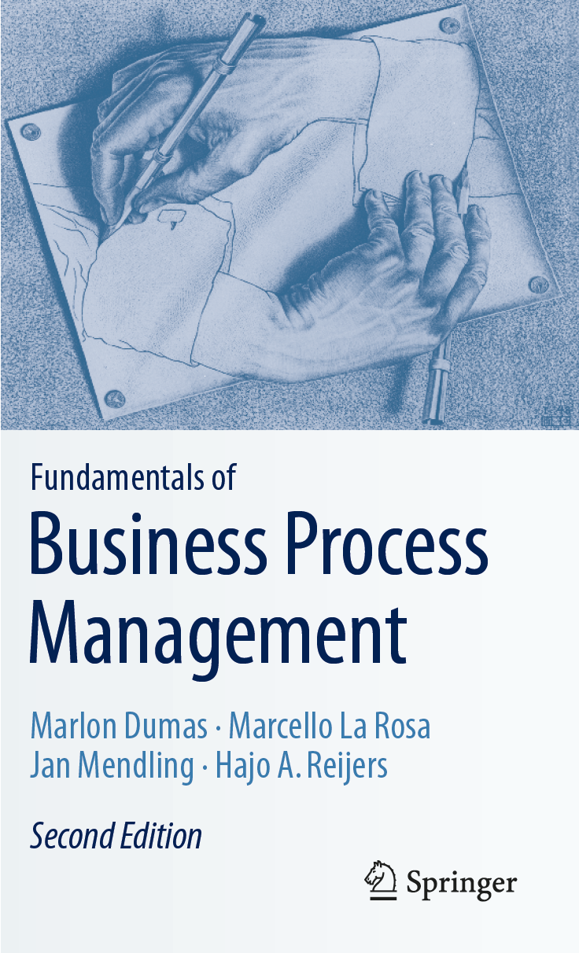
Chapter 7: Quantitative Process Analysis
Contents
Flow Analysis
Queuing Analysis
Simulation
Recap

Slide 2

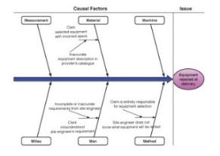
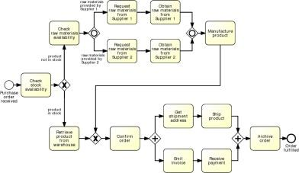

Process Analysis in the BPM Lifecycle

Slide 3
Chapter 7: Quantitative Process Analysis
Contents
Flow Analysis
Queuing Analysis
Simulation
Recap

Slide 4
Flow analysis
Process model
Performance of each activity
Process performance
Notes:
Flow analysis a technique to estimate and understand the performance of a process, given a process model and performance measures of the activities in the process
For example if we are given a process model and the cycle time of each activity in the process, we can use flow analysis to calculate the performance of the process. In doing so, we can understand where the performance of the process is coming from, that is, which activities in the process affect the most to the performance of the overall process.
In the following, we will show how flow analysis works using time measures, but we can do the same for cost and quality measures as discussed in the recommended readings.

Slide 5
Refresher: Process performance measures
Process performance
Time
Cost
Quality
Notes:
A great deal of BPM is about continuously assessing and improving process performance, particularly across three dimensions – time, cost and quality.
In order to improve performance, we first have to measure it, and this is where process performance measures come into play.
Identifying which performance measures are most relevant for a given process is an art on its own.
In this section we will see some common measures along each of these dimensions.
Let’s start with time.

Slide 6
Common time-related measures
Time taken by value-adding activities
Processing time
Waiting time
Cycle time
Time between start and completion of a process instance
Time taken by non-value-adding activities
Notes:
One of the most common time-related process performance measures is cycle time.
The cycle time of a process is the average time between the moment an instance of a process starts, and the moment it ends.
Cycle time has two components: the processing time, which is the time actually spent doing work, meaning doing activities of the process.
Waiting time, which is the rest of the time.
Waiting time has several sources as we will see subsequently, most notably the fact that a given activity may be ready to be executed, but the resource who will execute it is not available.

Slide 7
Cycle time efficiency
Processing Time
Cycle Time
Cycle Time Efficiency

Slide 8
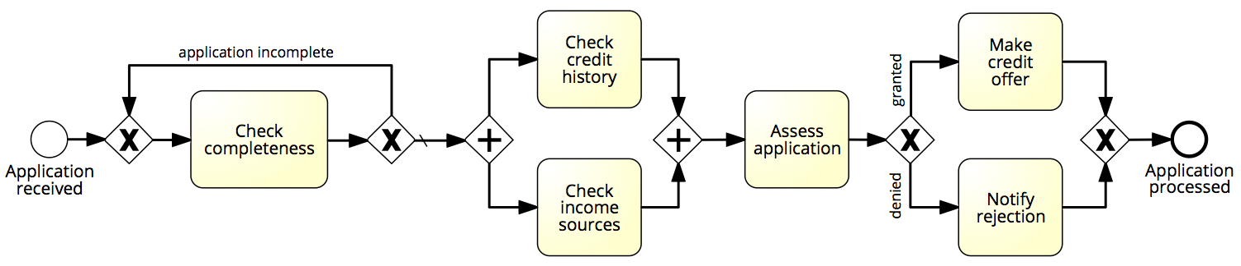
Flow analysis of cycle time
1 day
1 day
1 day
3 days
3 days
2 days
Cycle time = X days

Slide 9
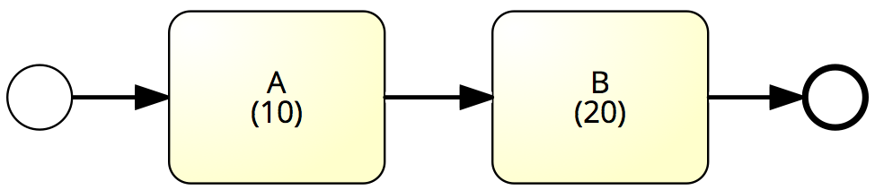
Sequence – Example
What is the average cycle time?
Cycle time = 10 + 20 = 30

Slide 10
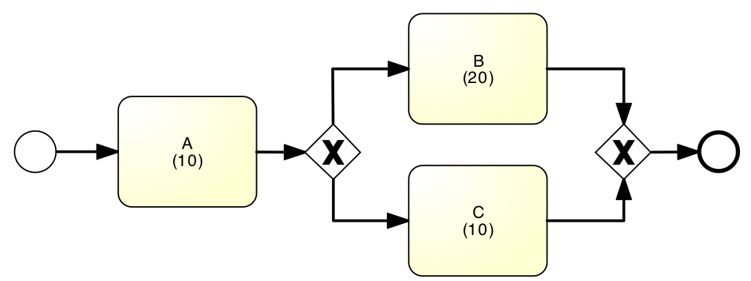
Example: Alternative Paths
What is the average cycle time?
50%
90%
50%
10%
Cycle time = 10 + (20+10)/2 = 25
Cycle time = 10 + 0.9*20+0.1*10 = 29

Slide 11
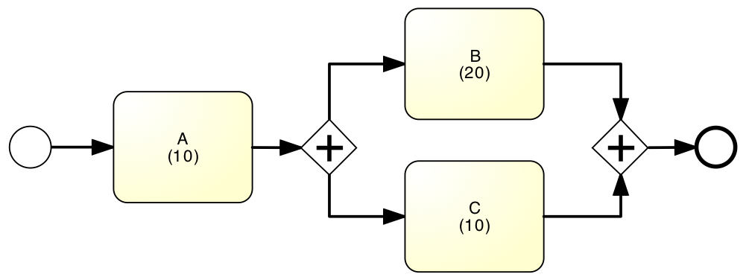
Example: Parallel paths
What is the average cycle time?
Cycle time = 10 + 20 = 30

Slide 12
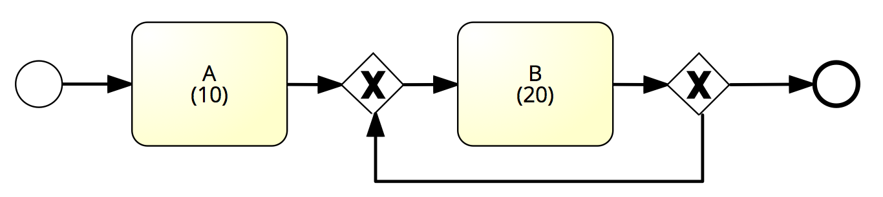
Example: Rework loop
What is the average cycle time?
80%
100%
1%
0%
99%
20%
Cycle time = 10 + 20 = 30
Cycle time = 10 + 20/0.01 = 2010
Cycle time = 10 + 20/0.8 = 35

Slide 13
Flow analysis equations for cycle time
CT = T₁+T₂+…+ T_{N}
CT = p₁*T₁+p₂*T₂+…+ p_{n}*T_{N}
CT = max(T₁, T₂,…, T_{N})
CT = T / (1-r)

Slide 14
Flow analysis of cycle time
1 day
1 day
20%
60%
80%
1 day
3 days
40%
3 days
2 days
1/0.8
max(1,3)
3
0.6*1+0.4*2
Cycle time = 1.25 + 3 + 3 + 1.4 = 8.65 days

Slide 15
Flow analysis of processing time
0.5 hour
2 hours
20%
60%
80%
2 hours
2 hours
40%
3 hours
0.5 mins.
2/0.8
max(0.5,3)
2
0.6*2+0.4*0.5
Processing time = 2.5 + 3 + 2 + 1.4 = 8.9 hours
Cycle time efficiency = 8.9 hours / 8.65 days = 12.9%

Slide 16
Flow analysis: scope and limitations
We have seen how to use flow analysis for processing & cycle time calculation
Flow analysis can also be applied to calculate:
The average cost of process instances (assuming we know the cost of each activity)
Cf. Section 7.1.6
The number of times on average each activity is executed
Can be used to calculate the “unit load” of each task, the resource utilization of each resource pool, and the theoretical capacity of an “as is” process
Cf. Section 7.1.5
But flow analysis has some fundamental limitations…

Slide 17
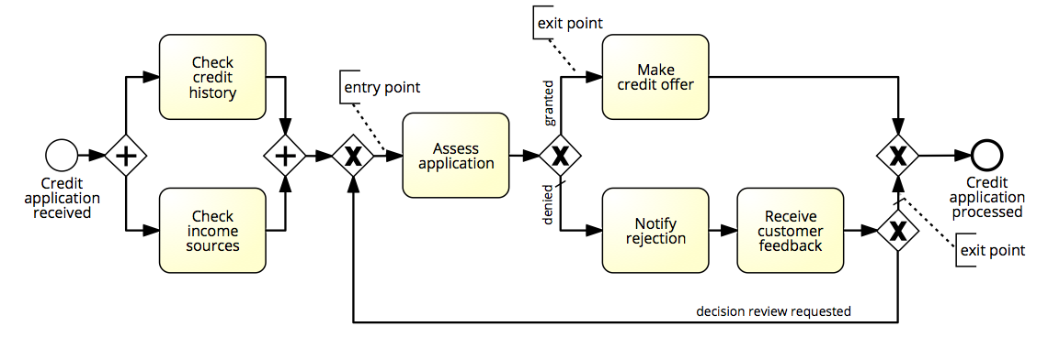
Limitation 1: Not all Models are Structured

Slide 18
Limitation 2: Fixed arrival rate capacity
Cycle time analysis does not consider:
The rate at which new process instances are created (arrival rate)
The number of available resources
Higher arrival rate at fixed resource capacity ➔ high resource contention ➔ higher activity waiting times (longer queues) ➔ higher activity cycle time ➔ higher overall cycle time
The slower you are, the more people have to queue up…
and vice-versa

Slide 19
Resource utilization
Time spent per resource on process work
Time available per resource for process work
Resource utilization
Resource utilization = 60%
➔ on average resources are idle 40% of their allocated time

Slide 20
Resource utilization vs. waiting time
Resource utilization
Waiting time
Typically, when resource utilization > 90%
➔ Waiting time increases steeply

Slide 21
Interlude: Cycle Time & Work-In-Progress
WIP = (average) Work-In-Process
Number of cases that are running (started but not yet completed)
E.g. # of active and unfilled orders in an order-to-cash process
WIP is a form of waste (cf. 7+1 sources of waste)
Little’s Formula: WIP = λ·CT
λ = arrival rate (number of new cases per time unit)
CT = cycle time

Slide 22
Exercise
A fast-food restaurant receives on average 1200 customers per day (between 10:00 and 22:00). During peak times (12:00-15:00 and 18:00-21:00), the restaurant receives around 900 customers in total, and 90 customers can be found in the restaurant (on average) at a given point in time. At non-peak times, the restaurant receives 300 customers in total, and 30 customers can be found in the restaurant (on average) at a given point in time.
What is the average time that a customer spends in the restaurant during peak times?
What is the average time that a customer spends in the restaurant during non-peak times?

Slide 23
Exercise (cont.)
The restaurant plans to launch a marketing campaign to attract more customers. However, the restaurant’s capacity is limited and becomes too full during peak times. What can the restaurant do to address this issue without investing in extending its building?

Slide 24
Chapter 7: Quantitative Process Analysis
Contents
Flow Analysis
Queuing Analysis
Simulation
Recap

Slide 25
Queuing Analysis
Capacity problems are common and a key driver of process redesign
Need to balance the cost of increased capacity against the gains of increased productivity and service
Queuing and waiting time analysis is particularly important in service systems
Large costs of waiting and/or lost sales due to waiting
Example – Emergency Room (ER) at a Hospital
Patients arrive by ambulance or by their own accord
One doctor is always on duty
More patients seeks help ⇒ longer waiting times
Should we increase the capacity from one to two doctors?
Inspired by an example by Laguna & Marklund (2004)

Slide 26
Delay is Caused by Job Interference
If arrivals are regular or sufficiently spaced apart, no queuing delay occurs
Deterministic traffic
Variable but spaced apart traffic
© Dimitri P. Bertsekas
Notes:
Queuing occurs every time user demand exceeds server capacity.
Delays are due to several reasons. Let’s examine some of them…

Slide 27
Burstiness Causes Interference
Queuing results from variability in processing times and/or interarrival times
© Dimitri P. Bertsekas
Notes:
What does “bursty traffic” mean?

Slide 28
High Utilization Exacerbates Interference
The queuing probability increases as the load increases
Utilization close to 100% is unsustainable → too long queuing times
© Dimitri P. Bertsekas
Notes:
Delay probability is higher under heavy loading conditions than when the traffic is light

Slide 29
The Poisson Process
Common arrival assumption in many queuing and simulation models
The times between arrivals are independent, identically distributed and exponential
P (arrival < t) = 1 – e^{-λt}
This distribution is applicable when the next arrival (i.e. the next creation of a case) does not depend on how long ago the previous arrival occurred
In other words, the creation of a case is independent of the creation of other cases.
Inspired by slide by Laguna & Marklund (2004)
Notes:
A useful queuing model represents a real-life system with sufficient accuracy and is analytically tractable. A queuing model based on the Poisson process often meets these two requirements. A Poisson process models random events (such as a customer arrival, a request for action from a web server, or the completion of the actions requested of a web server) as emanating from a memoryless process. That is, the length of the time interval from the current time to the occurrence of the next event does not depend upon the time of occurrence of the last event
Independent increments: the numbers of occurrences counted in disjoint intervals are independent from each other
Stationary increments: the probability distribution of the number of occurrences counted in any time interval only depends on the length of the interval
Closed under Addiction and Subtraction

Slide 30
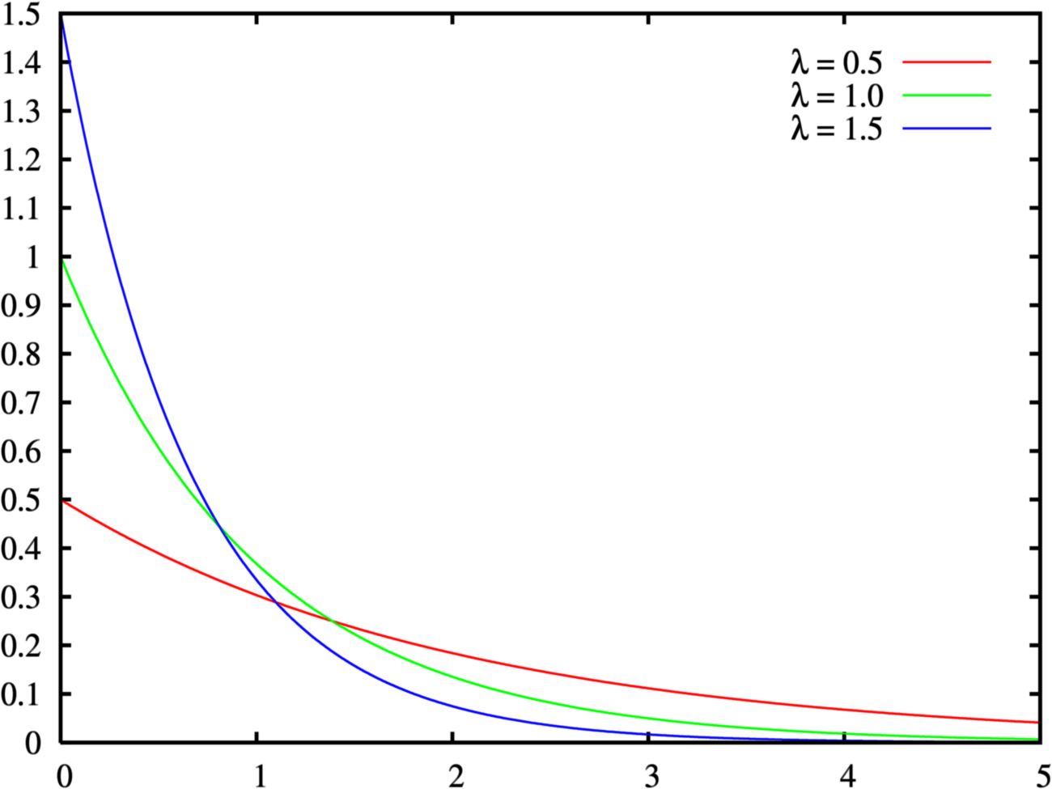
Negative Exponential Distribution

Slide 31
Queuing theory: basic concepts
waiting
service
arrivals
λ
c
μ
Basic characteristics:
λ (mean arrival rate) = average number of arrivals per time unit
μ (mean service rate) = average number of jobs that can be handled by one server per time unit:
c = number of servers
© Wil van der Aalst

Slide 32
Queuing theory concepts (cont.)
λ
c
μ
Wq,Lq
W,L
Given λ , μ and c, we can calculate :
occupation rate: ρ
Wq = average time in queue
W = average system in system (i.e. cycle time)
Lq = average number in queue (i.e. length of queue)
L = average number in system average (i.e. Work-in-Progress)
© Wil van der Aalst

Slide 33
M/M/1 queue
λ
1
μ
Assumptions:
time between arrivals and processing time follow a negative exponential distribution
1 server (c = 1)
FIFO
L=ρ/(1- ρ)
L_{q}= ρ²/(1- ρ) = L-ρ
W=L/λ=1/(μ- λ)
Wq=Lq/λ= λ /( μ(μ- λ))
Inspired by a slide by Laguna & Marklund (2004)

Slide 34
M/M/c queue
Now there are c servers in parallel, so the expected capacity per time unit is then c*μ
Little’s Formula ⇒ Wq=Lq/λ
W=Wq+(1/μ)
Little’s Formula ⇒ L=λW
Inspired by a slide by Laguna & Marklund (2004)

Slide 35
Tool Support
For M/M/c systems, the exact computation of Lq is rather complex…
Consider using a tool, e.g.
http://www.supositorio.com/rcalc/rcalclite.htm
http://queueingtoolpak.org/ (for Excel)

Slide 36
Example – ER at County Hospital
Situation
Patients arrive according to a Poisson process with intensity λ (⇔ the time between arrivals is exp(λ) distributed.
The service time (the doctor’s examination and treatment time of a patient) follows an exponential distribution with mean 1/μ (=exp(μ) distributed)
The ER can be modeled as an M/M/c system where c = the number of doctors
Data gathering
λ = 2 patients per hour
μ = 3 patients per hour
Question
Should the capacity be increased from 1 to 2 doctors?
Inspired by a slide by Laguna & Marklund (2004)

Slide 37
Queuing Analysis – Hospital Scenario
Interpretation
To be in the queue = to be in the waiting room
To be in the system = to be in the ER (waiting or under treatment)
Should we increase the capacity from one to two doctors?
Characteristic | One doctor (c=1) | Two Doctors (c=2)
ρ | 2/3 | 1/3
Lq | 4/3 patients | 1/12 patients
L | 2 patients | 3/4 patients
Wq | 2/3 h = 40 minutes | 1/24 h = 2.5 minutes
W | 1 h | 3/8 h = 22.5 minutes
Inspired by a slide by Laguna & Marklund (2004)

Slide 38
Limitations of basic queuing models
Can be used to analyze waiting times (and hence cycle times), but not cost or quality measures
Suitable for analyzing one single activity at a time, performed by one single resource pool. Not suitable for analyzing end-to-end processes consisting of multiple activities performed by multiple resource pools.
These limitations are addressed by process simulation

Slide 39
Chapter 7: Quantitative Process Analysis
Contents
Value-Added Analysis
Queuing analysis
Simulation
Recap

Slide 40
Process Simulation
Versatile quantitative analysis method for
As-is analysis
What-if analysis
In a nutshell:
Run a large number of process instances
Gather performance data (cost, time, resource usage)
Calculate statistics from the collected data

Slide 41
Process Simulation
Model the process
Define a simulation scenario
Run the simulation
Analyze the simulation outputs
Repeat for alternative scenarios

Slide 42
Example

Slide 43
Example

Slide 44
Elements of a simulation scenario
Processing times of activities
Fixed value
Probability distribution

Slide 45
Exponential Distribution

Slide 46
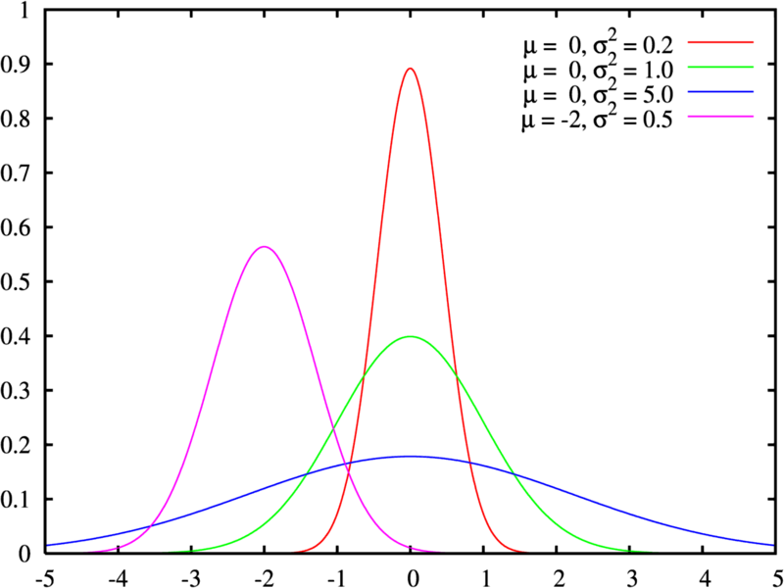
Normal Distribution

Slide 47
Choice of probability distribution
Fixed
Rare, can be used to approximate case where the activity processing time varies very little
Example: a task performed by a software application
Normal
Repetitive activities
Example: “Check completeness of an application”
Exponential
Complex activities that may involve analysis or decisions
Example: “Assess an application”

Slide 48
Simulation Example
Normal(10m, 2m)
Normal(10m, 2m)
0m
Exp(20m)
Normal(20m, 4m)
Normal(10m, 2m)

Slide 49
Elements of a simulation model
Processing times of activities
Fixed value
Probability distribution
Conditional branching probabilities
Arrival rate of process instances and probability distribution
Typically exponential distribution with a given mean inter-arrival time
Arrival calendar, e.g. Monday-Friday, 9am-5pm, or 24/7

Slide 50
Branching probability and arrival rate
Arrival rate = 2 applications per hour
Inter-arrival time = 0.5 hour
Negative exponential distribution
From Monday-Friday, 9am-5pm
0.3
0.7
0.3
35m
55m
9:00
11:00
12:00
13:00
14:00
10:00

Slide 51
Elements of a simulation model
Processing times of activities
Fixed value
Probability distribution
Conditional branching probabilities
Arrival rate of process instances
Typically exponential distribution with a given mean inter-arrival time
Arrival calendar, e.g. Monday-Friday, 9am-5pm, or 24/7
Resource pools
Notes:
Resource pools in this context is not to be confused with pools in BPMN. A resource pool here is simply a set of resources who can perform a given activity. A resource pool for example can be a role or a group. In a way resource pool in the context of simulation is closer to the notion of “lane” in BPMN and typically lanes in BPMN will become resource pools when we simulate the process.

Slide 52
Resource pools
Name
Size of the resource pool
Cost per time unit of a resource in the pool
Availability of the pool (working calendar)
Examples
Clerk Credit Officer
€ 25 per hour € 25 per hour
Monday-Friday, 9am-5pm Monday-Friday, 9am-5pm
In some tools, it is possible to define cost and calendar per resource, rather than for entire resource pool
Notes:
To specify a resource pool we need of course to give it a name.
We also have to specify the size of the pool, meaning how many resources belong to it.
Finally, we

Slide 53
Elements of a simulation model
Processing times of activities
Fixed value
Probability distribution
Conditional branching probabilities
Arrival rate of process instances and probability distribution
Typically exponential distribution with a given mean inter-arrival time
Arrival calendar, e.g. Monday-Friday, 9am-5pm, or 24/7
Resource pools
Assignment of tasks to resource pools

Slide 54
Resource pool assignment
Clerk
Officer
System
Officer
Clerk
Officer

Slide 55
Process Simulation
Model the process
Define a simulation scenario
Run the simulation
Analyze the simulation outputs
Repeat for alternative scenarios
✔
✔
✔

Slide 56
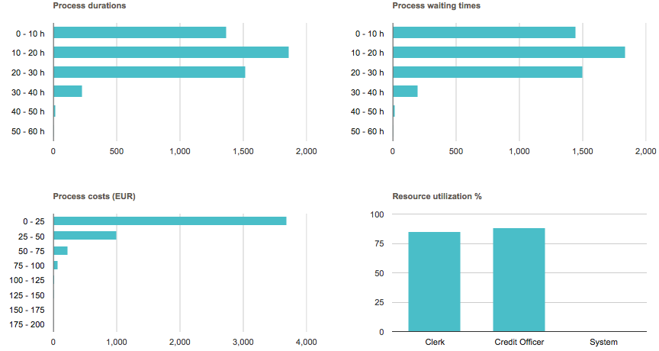
Output: Performance measures & histograms

Slide 57
Process Simulation
Model the process
Define a simulation scenario
Run the simulation
Analyze the simulation outputs
Repeat for alternative scenarios
✔
✔
✔
✔

Slide 58
Tools for Process Simulation
ARIS
Bizagi Process Modeler
ITP Commerce Process Modeler for Visio
Logizian
Oracle BPA
Progress Savvion Process Modeler
ProSim
Signavio + BIMP

Slide 59
BIMP – bimp.cs.ut.ee
Accepts standard BPMN 2.0 as input
Simple form-based interface to enter simulation scenario
Produces KPIs + simulation logs in MXML format
Simulation logs can be imported to the ProM process mining tool

Slide 60
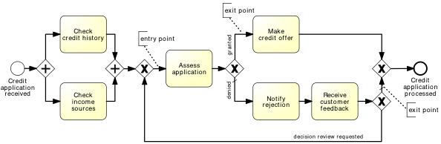
BIMP Demo
https://www.youtube.com/watch?v=TjXl6yASCSc

Slide 61
Pitfalls of simulation
Stochasticity
Data quality pitfalls
Simplifying assumptions

Slide 62
Stochasticity
Simulation results may differ from one run to another
Make the simulation tiemframe long enough to cover weekly and seasonal variability, where applicable
Use multiple simulation runs
Average results of multiple runs, compute confidence intervals

Slide 63
Data quality pitfalls
Simulation results are only as trustworthy as the input data
Rely as little as possible on “guesstimates”
Use input analysis
Deriver simulation scenario parameters from numbers in the scenario
Use statistical tools to check fit the probability distributions
Simulate the “as is” scenario and cross-check results against actual observations

Slide 64
Simulation assumptions
That the process model is always followed to the letter
No deviations
No workarounds
That there is no multi-tasking (the same resource performs multiple tasks concurrently) nor batching (tasks being accumulated and performed in a single go)
That resources work constantly and non-stop
Every day is the same!
No tiredness effects
No distractions beyond “stochastic” ones

Slide 65
Chapter 7: Quantitative Process Analysis
Contents
Value-Added Analysis
Queuing analysis
Simulation
Recap

Slide 66
Recap
Assuming we have performance measures for each activity in a process, flow analysis allows us to calculate the following performance measures for an “as is” process:
Cycle time, processing times, cycle time efficiency of a process
Average cost per process instance
It can also be used to calculate the theoretical capacity of an “as is” process and the resource utilization of resource pools
But it is not suitable for “what if” analysis
Queing analysis is a suitable technique for “what if” analysis of waiting times and cycle times, suitable for analyzing individual activities performed by one resource pool
Simulation is a versatile technique for “what if” analysis of entire processes, covering waiting times, cycle times, and costs.
Particularly useful for identifying bottlenecks

